Slide 1
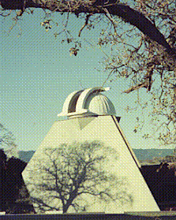

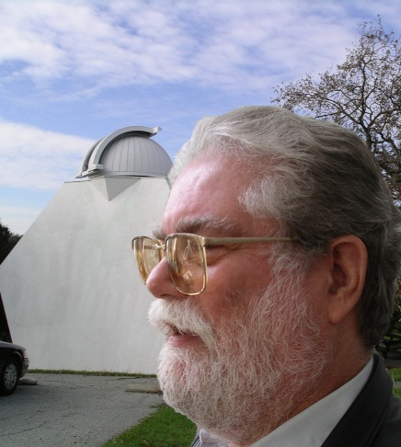
The Machine Teaching Approach to Unsupervised Construction of a Sunspot Group Number Backbone
https://leif.org/research/
leif@leif.org
Leif Svalgaard, Stanford University
May 25, 2022
I'll discuss a tool to 'teach' a machine [a 1000-line Python program] to construct [in typically 10-15 minutes] backbones for any given primary observer automatically [with no further input from the researcher]. This makes the process transparent and reproducible, leaving the linking of backbones as the real issue with much starker drawn lines to form a base for rational and unbiased scientific discussions [and potential consensus].
2022-05-24

Slide 2
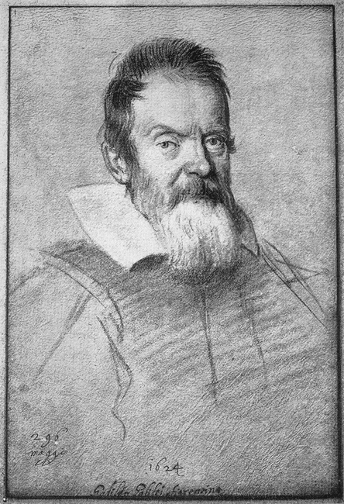
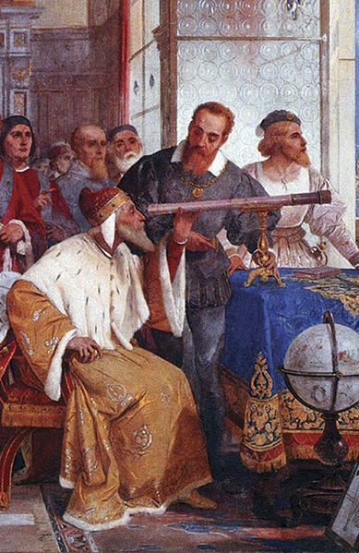
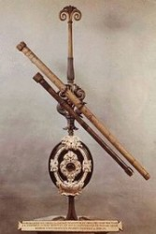
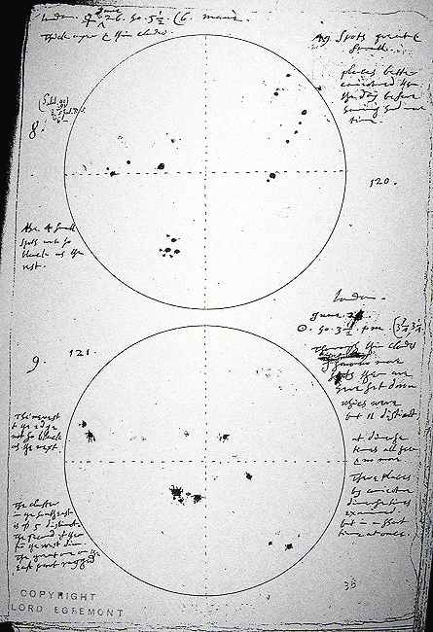
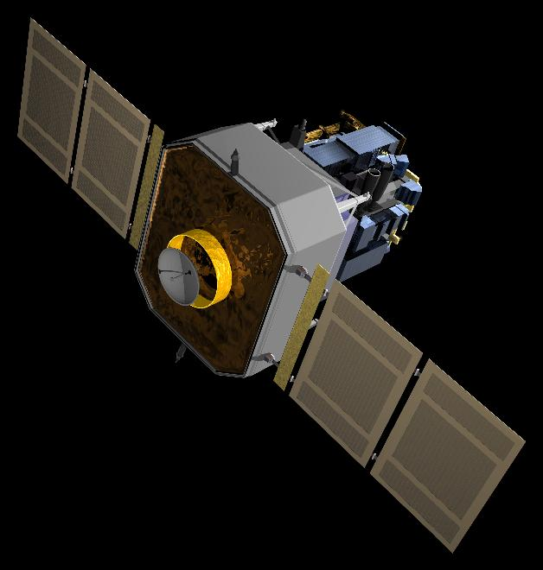
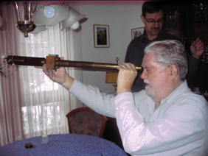
Centuries of Sunspot Observing
We have observed sunspots with telescopes for 400+ years
Galileo Galilei
Groups
June 23, 1613
Thomas Hariott 1610
Galileo Galilei
Galileo’s Telescope
Maximum
Minimum
SOHO
March 29, 2001
January 7, 2005
Rudolf Wolf 1816-1893
Wolf’s Telescope
Sunspots observed by Spacecraft
‘Compiler’ of Sunspot Number
Still used today
The sunspot number is always determined using small telescopes

Slide 3
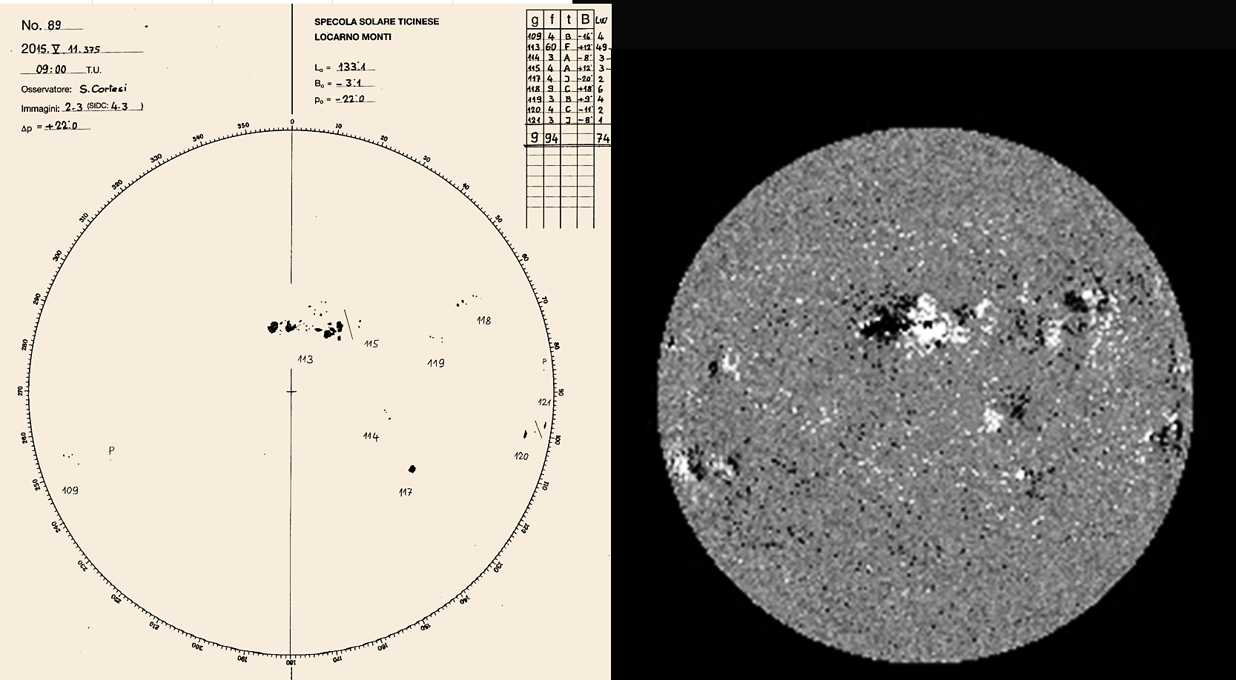
Sunspot Groups = Active Regions
HMI 2015-05-11
SergioCortesi

Slide 4
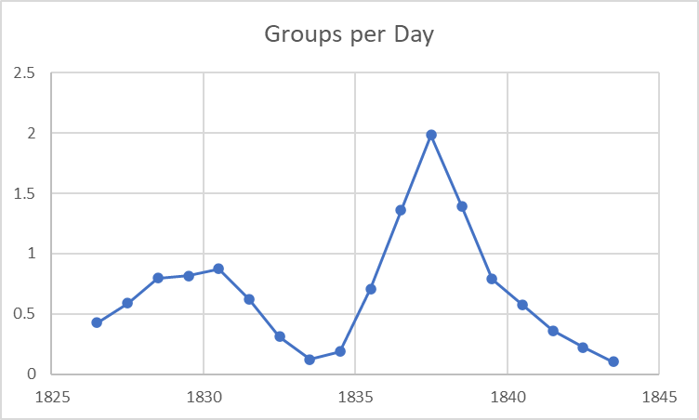
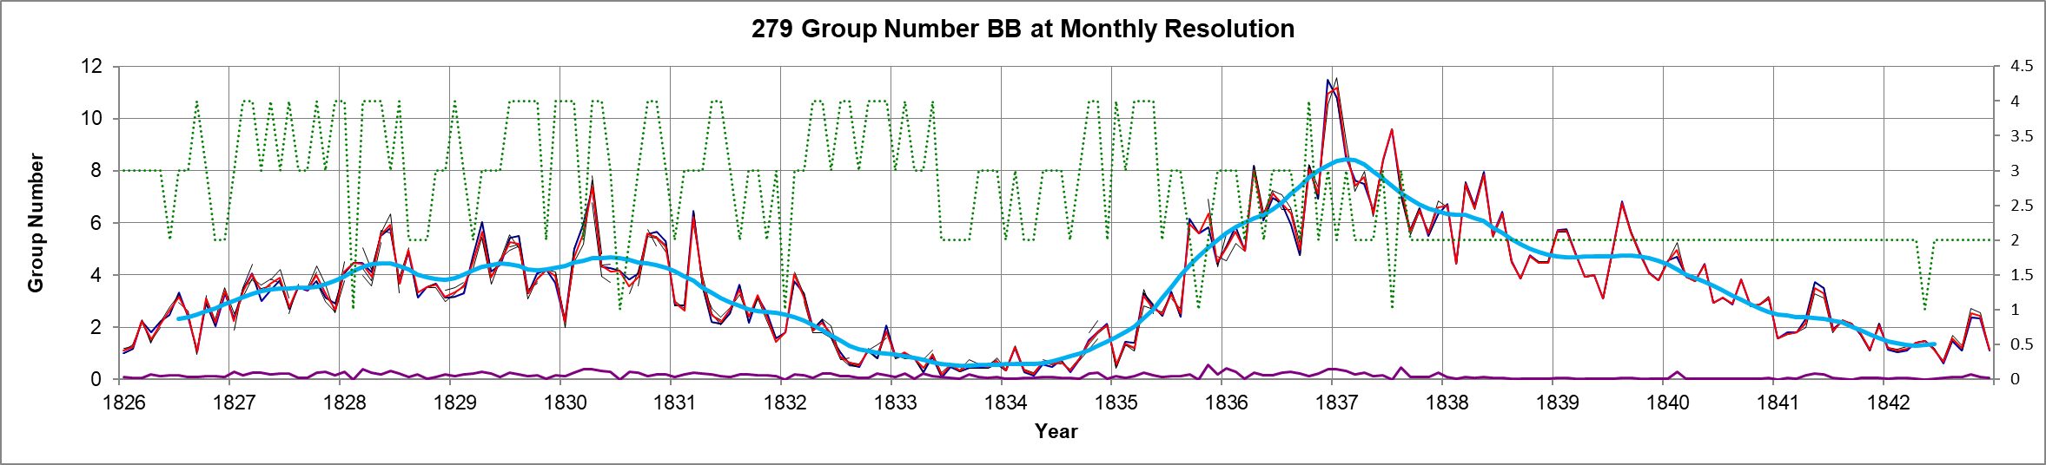
The Discoverer of the Sunspot Cycle counted (new) Groups
H.S.Schwabe: (1844) Astronomische Nachrichten, volume 21, issue 15, p.233

Slide 5
Rudolf Wolf’s Famous Formula and the Importance of Groups
As Schwabe, Wolf saw the ‘Group’ as the basic element of solar activity
When a new location on the Sun is ‘attacked’ by the spot-forming process this is much more important than just adding a new spot to an existing group
Wolf took the number of spots as a measure of the ‘size’ of the group
Rudolf Wolf (1950) Astronomische Mitteilungen der Eidgenössischen Sternwarte Zürich, vol. 1, pp.127-157. Mittheilungen VI

Slide 6
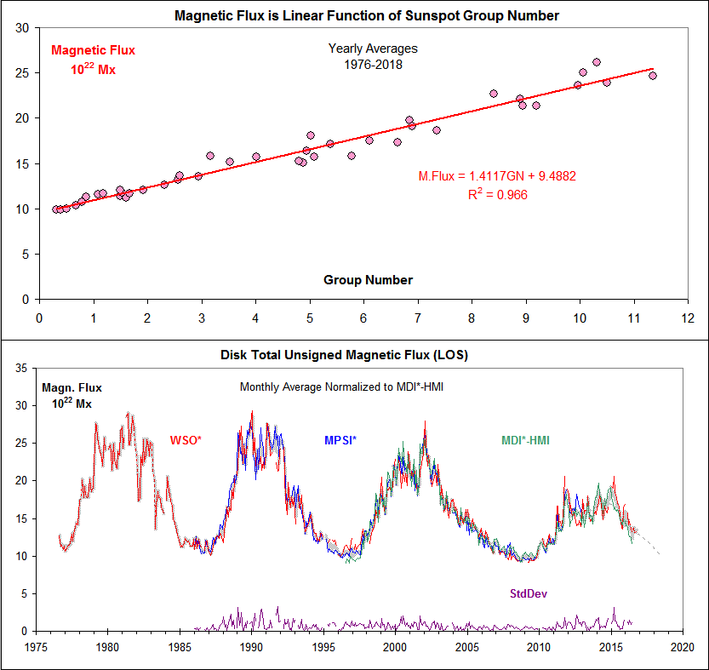
Magnetic Flux back to 1976 and the Sunspot Group Number (SS16)
Scaling MWO to MDI-HMI and WSO to the result yields a good measure of the LOS unsigned full disk magnetic flux which turns out to be a linear function of the Sunspot Group Number (S&S 2016).
Even at the limit of zero Groups there is still a significant amount of solar magnetic flux as needed to explain the interplanetary flux.

Slide 7
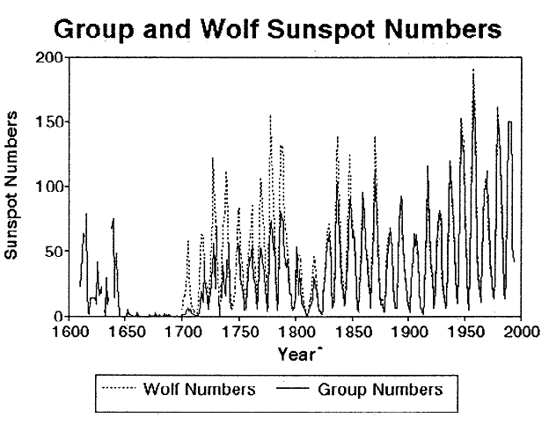
The Hoyt & Schatten Reconstruction
Hoyt, Douglas V.; Schatten, Kenneth H.; Nesme-Ribes, Elizabeth: The one hundredth year of Rudolf Wolf's death: Do we have the correct reconstruction of solar activity? Geophysical Research Letters, Volume 21, Issue 18, p. 2067-2070, 1994
Hoyt, Douglas V.; Schatten, Kenneth H.: Group Sunspot Numbers: a new solar activity reconstruction. Sol. Phys. 179, 189–219, 1998. [HS98 in what follows]
“In this paper, we construct a time series known as the Group Sunspot Number. […] The generation and preliminary analysis of the Group Sunspot Numbers allow us to make several conclusions: (1) Solar activity before 1882 is lower than generally assumed and consequently solar activity in the last few decades is higher than it has been for several centuries.” [Other researchers have claimed for more than ≈10,000 years]
The Problem: Two Very Different ‘Sunspot Series’. Which One to Use?
Original Wolf Number: W_{o} = Groups + 1/10 Spots. (‘1/10 Spots’ was assumed to be a measure of the area of the group). W = k 10 W_{o}
Galileo
18th
Scheiner
H&S GSN = 12 G where the ‘12’ was chosen to make the GSN = W for the interval 1874-1976
M.M.

Slide 8
Sunspot Areas Since the 1880s
Wolfer Sunspot Number
H&S Group Number
Hathaway et al. (2002), Solar Physics 211: 357–370
The H&S GSN and the Wolf/Wolfer SSN are almost equally well correlated with the area of the active regions on the disk, so Wolf’s assumption that his SSN was a good representation of solar activity is vindicated. Same for the Number of Groups. So, the Areas, GSN, and SSN should all agree (when scaled) and they (mostly) do after about AD 1882, but …

Slide 9
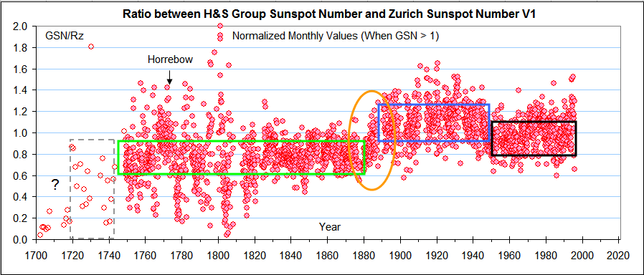
There are Large and Systematic Discrepancies between GSN and SSN
Waldmeier Jump
~40%
~20%
The ratio of the H&S GSN and the Official [“Zürich”] Relative Sunspot Number [version 1] (when not too small) reveals some systematic variations, related to the choice of observers…

Slide 10
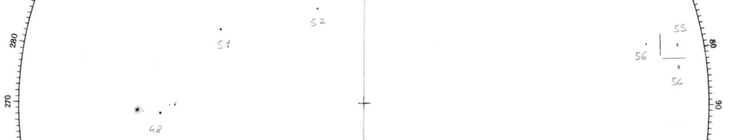
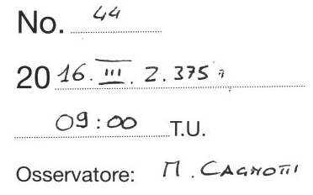
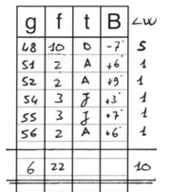
It is now well Established that Locarno Observers Weight the Sunspot Count
Not weighted
Rw = 6*10 + 22 = 82 R = 6*10 + 10 = 70 w = 82/70 = 1.171
1;3
3;1
2
Waldmeier’s Weighting Rules: “A spot like a fine point is counted as one spot; a larger spot, but still without penumbra, gets the statistical weight 2, a smallish spot with penumbra gets 3, and a larger one gets 5.” Presumably there would be spots with weight 4, too
The Locarno observers since August 3, 2014 report both weighted and un-weighted spot counts, but anybody can also determine the un-weighted count by simply counting spots on the drawings [back to 1957; since 1981 online]. When we remove the weighting, the 1945 discrepancy disappears.

Slide 11


Ken Schatten and I proposed a Novel Way of Resolving the Remaining Problem
Building a long time series from observations made over time by several observers can be done in at least two ways:
Daisy-chaining: successively joining observers to the ‘end’ of the series, based on overlap with the series as it extends so far [accumulates errors]
Back-boning: find a ‘good’ primary observer for a certain [long] interval and normalize all other observers individually to the primary based on overlap with only the primary [no accumulation of errors]
Chinese Whispers
When several backbones have been constructed, we can join [daisy-chain] the backbones. Each backbone can be improved individually without impacting other backbones. If the number of backbones is small, error accumulation is also small.
Backbone

Slide 12
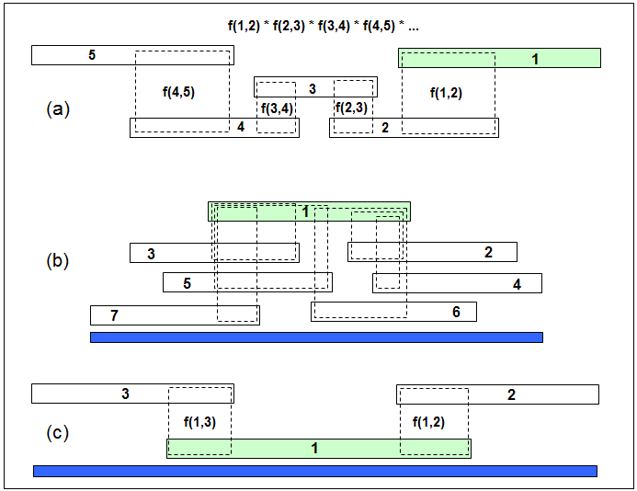
Daisy-Chaining: When is it and When is it Not (Backbones)
This is Daisy-Chaining
Error Accumulation: E15=SQRT(E12²+E23²+E34²+E45²) i.e. increases with the number of observers
Observer 1
Time
f(n,m) is the scale factor from m to n
Connect observer 1 with observer 5: f(1,5) = f(1,2)*f(2,3)*f(3,4)*f(4,5)
This is Not
No ‘intermediate’ observers
The ‘effective’ scale factor is an average of all the individual factors <f(n,1)>.
The error of the average decreases with the number of observers
Ken Schatten (the ‘S’ of H&S) and myself (realizing that the H&S reconstruction of the Group Sunspot Number was flawed) decided [in 2014-2016] to try again but using the ‘Backbone’ methodology on yearly averages of the observations instead of the daisy-chaining employed by H&S [for data before 1882]

Slide 13
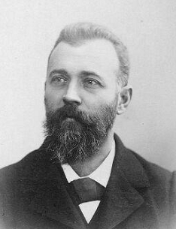
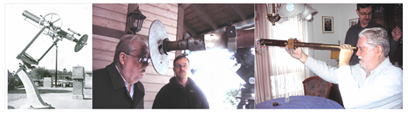
The Wolfer Backbone
Alfred Wolfer observed 1876-1928 with the ‘standard’ 80 mm telescope
Rudolf Wolf from 1860 on mainly used smaller 37 mm telescope(s) so those observations are used for the Wolfer Backbone
80 mm X64
37 mm X20

Slide 14
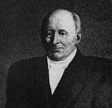
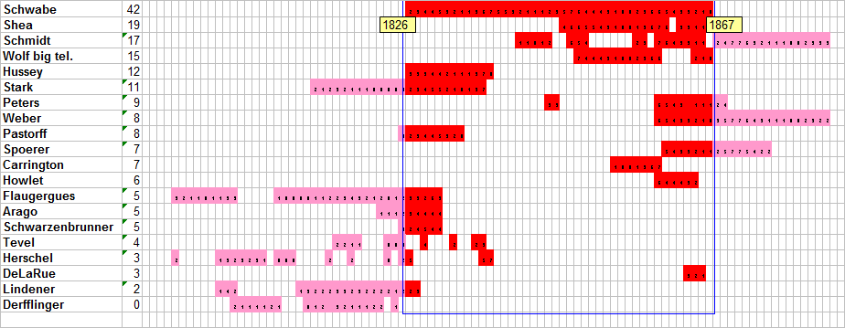
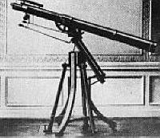
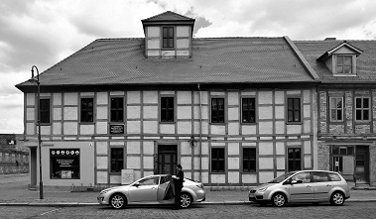
The Schwabe Backbone
Schwabe received a 50 mm telescope from Fraunhofer in 1826 Jan 22. This telescope was used for the vast majority of full-disk drawings made 1826–1867.
For this backbone we use Wolf’s observations with the large 80mm standard telescope
?
Schwabe’s House

Slide 15
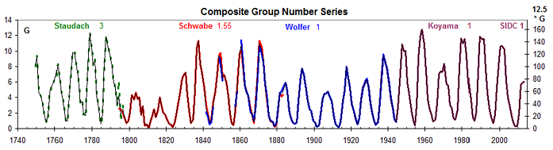
Joining two Backbones
Comparing Schwabe with Wolfer backbones over 1860-1883 we find a normalizing factor of 1.55
The Group Sunspot Number is now defined as 12 * Number of Groups

Slide 16
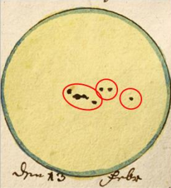
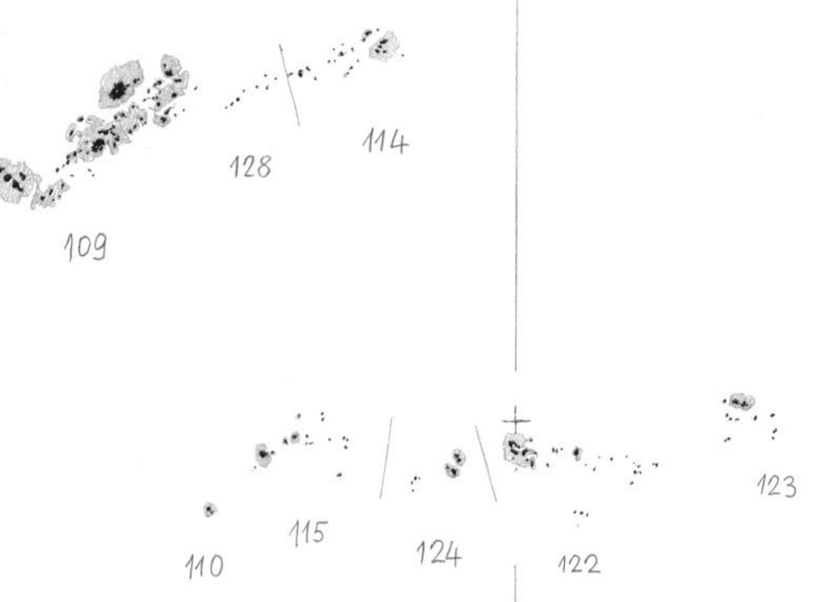

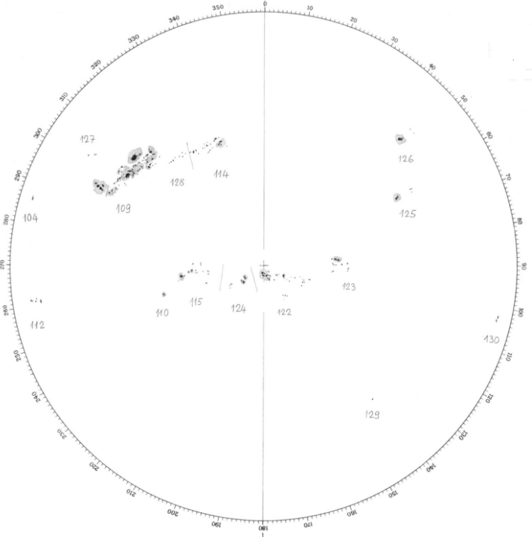
Fundamental Issue: What Is a Group?
Definition has changed over time
Wolf (1857) counted only one group on that day.
Modern observers (Cortesi, even me) would count at least three groups.
Staudach 13 Feb. 1760
Contrary to common belief, counting spots is easy, counting groups is hard
?
Cortesi counted 8 groups. Early observers would likely have counted only 5 groups
Locarno

Slide 17
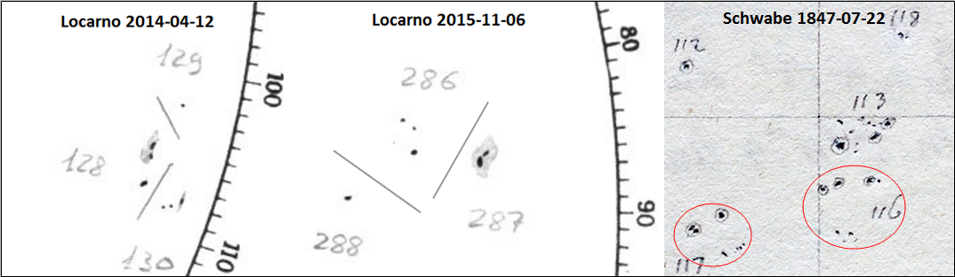
Groups are HARD to determine
Pavai et al. 2015
Kopecký et al. (1980) cite the Zürich observer Zelenka drawing attention to the possible inflationary effect of the introduction of the Waldmeier Group Classification around 1940. The Classification offered a unified definition including taking into account the temporal evolution of the group.
Early on, a sunspot group was defined solely on the basis of its morphology and location relative to other groups. Sunspot groups were at first considered just to be spatially separate assemblies of sunspots.

Slide 18
The Raw Group Database
NUMBER OF SUNSPOT GROUPS FOR THE YEAR: 1938
AS OBSERVED BY: MADRID OBSERVATORY, MADRID
Day Jan Feb Mar Apr May Jun Jul Aug Sep Oct Nov Dec
---------------------------------------------------------------
1 -99 6 6 5 -99 12 10 -99 12 -99 13 5
2 -99 5 -99 5 -99 10 10 -99 12 -99 -99 6
3 -99 4 6 5 9 12 -99 13 -99 -99 -99 6
4 -99 6 4 5 10 12 9 14 -99 8 15 -99
5 5 5 -99 -99 9 11 10 14 -99 9 13 10
6 6 6 -99 6 8 14 -99 12 -99 -99 -99 -99
7 7 6 4 6 10 18 13 -99 -99 8 12 10
8 4 5 5 6 -99 19 -99 12 9 6 12 10
9 -99 4 5 5 -99 17 -99 13 8 -99 9 9
10 -99 8 7 -99 12 15 -99 -99 8 9 -99 9
11 6 7 10 -99 11 16 13 14 -99 -99 7 -99
12 7 8 7 7 10 -99 13 13 4 -99 9 -99
13 6 7 9 6 9 14 14 14 4 -99 -99 -99
14 5 7 -99 6 8 13 13 10 -99 7 -99 12
15 6 6 8 8 -99 17 15 11 3 7 9 9
16 -99 9 10 6 8 -99 18 13 6 -99 10 -99
17 6 6 10 -99 7 -99 -99 12 6 5 10 -99
18 4 7 8 -99 7 -99 11 9 -99 4 10 -99
19 8 7 5 8 7 -99 12 11 6 -99 7 -99
20 7 -99 6 7 8 -99 -99 11 6 4 -99 9
21 8 6 5 6 7 -99 15 -99 8 5 -99 -99
22 9 7 -99 6 -99 -99 -99 -99 5 5 -99 -99
23 12 6 3 7 11 -99 15 12 6 -99 6 -99
24 12 -99 -99 5 -99 -99 -99 13 -99 -99 8 -99
25 8 5 3 -99 12 7 17 14 -99 -99 8 -99
26 8 5 3 -99 12 -99 16 11 11 9 4 5
27 7 -99 4 -99 8 18 -99 -99 -99 10 -99 5
28 5 4 3 -99 -99 18 15 -99 -99 13 6 4
29 -99 -99 4 -99 -99 18 14 10 13 11 -99 5
30 6 -99 4 8 -99 17 12 10 -99 -99 5 4
31 5 -99 5 -99 11 -99 -99 9 -99 14 -99 6
means: 6.8 6.1 5.8 6.2 9.2 14.6 13.3 12.0 7.5 7.9 9.1 7.3
Hoyt and Schatten in a monumental effort collected a vast amount of daily group counts since 1610 and published the data in an easy-to-read (for a human) text format. The Group Sunspot Numbers use 65941 observations from 117 observers active before 1874 that were not used by Wolf in constructing his time series.
Vaquero, Svalgaard, Carrasco, et al. have reformatted the H&S database and added a large amount of new data covering the time until the present. The revised and updated database now contains 1,174,241 observations by ~750 observers. The data is freely available from http://haso.unex.es/haso/ and is constantly growing and revised.

Slide 19
Our Backbone Method has these elements:
Identifying a Primary Observer and all other observers who overlaps in time with the primary
Finding the mapping from these observers to the primary by regression, and
Constructing the Backbone by applying the mapping functions for the observers and averaging the so scaled observations
Many backbones can be constructed covering a given time interval by choosing different primaries and they can be combined by suitable weighting to form a ‘super backbone’ for the interval
Backbones can be linked by Daisy-chaining to form a final time series of solar activity. (That is the topic for another talk)
Here we shall concentrate on automatic generation of backbones from the raw group database.
We use a Python program to generate an Excel spreadsheet for distributing and visualization of the backbone
We shall construct the backbone with monthly resolution. This mostly solves the problem of data gaps and observations not taken at the same time

Slide 20
Raw Database Format
1984 4 24 659 1 3
1984 4 24 671 1 4
1984 4 24 681 1 5
1984 4 24 685 1 3
1984 4 24 688 1 5
1984 4 24 693 1 5
1984 4 24 696 1 6
1984 4 24 697 1 6
1984 4 24 701 1 6
1984 4 24 702 1 5
1837 6 9 279 1 7
1837 6 10 0 0 -1
1837 6 11 0 0 -1
1837 6 12 279 1 8
1837 6 13 279 1 8
1837 6 14 0 0 -1
1837 6 15 279 1 7
1837 6 15 280 1 9
1837 6 16 0 0 -1
1837 6 17 279 1 6
1837 6 18 274 1 9
The records [“lines”] refer to one observation by a given observer:
Year
Month
Day (Gregorian Calendar)
Observer ID
Flag
Group Count
Missing data have a flag of ‘0’ and a group count of ‘-1’
or simply a missing record
The data can be in any order, i.e., not necessarily sorted in time. New data can simply be added to the bottom of the database.

Slide 21
Python 3.10 with Spyder 5.2
# -*- coding: utf-8 -*-
"""
Updated on Wed May 25 2922 Current version
@author: Leif Svalgaard, Stanford University
"""
# pylint: disable=C0103,C0116,C0200,C0321,C0325,C0410
# pylint: disable=C0411,C0413,C0415,C1801
# pylint: disable=R0124,R0912,R0913,R0914,R0915,R1702
# pylint: disable=R1703,R1705,R1710,R1711,R1719,R1726
# pylint: disable=R1727,R1731,R1732
# pylint: disable=W0102,W0104,W0105,W0125,W0612,W0613
# pylint: disable=W0614,W0621,W0622,W0640,W0702,W0703
# pylint: disable=E1101,E1136,E1137,E1601
# The above complaints I ignore for good reasons
with open("BB-Set-Up.txt",'w') as BB:
""" To hold set up information. """
Ref = 279
fyear = 1826; Fy = str(fyear)
tyear = 1843 # top year
dyear = 1 # min years span
atLeast = 1 # at least that many days in the month
MinR2 = 0.80 # minimum coefficient of determination
spread = 2.0 # spread control
In000 = 1 # include 000 as obs if 1
OnlyRef = 0 # Only get Ref series if 1
Clean = 1 # clean up if 1
Plot = 1 # plot if 1
Show = 1 # console output if 1
OutDet = 0 # outlier details if 1
Tag = 'A' # tag for name
ManyObs = 1-OnlyRef
OutDet *= Show
print(Ref,fyear,tyear,dyear,
atLeast,MinR2,spread,In000,OnlyRef,
Clean,Plot,Show,OutDet,Tag,file=BB)
Design Criteria:
1: All in one file, so no issue with version control of dependencies
2: Avoid being ‘pythonic’ which impairs readability for non-python readers
3: Define functions and imports where they are used rather than all up front
4: Avoid sprawling and skinny constructs eating up screen space
5: Take advantage of (nearly) infinite (free) storage and (nearly) infinite processing speed
6: Minimize use of external libraries
7: Comment sparingly if at all
8: Use the least sophisticated code that gets it done

Slide 22
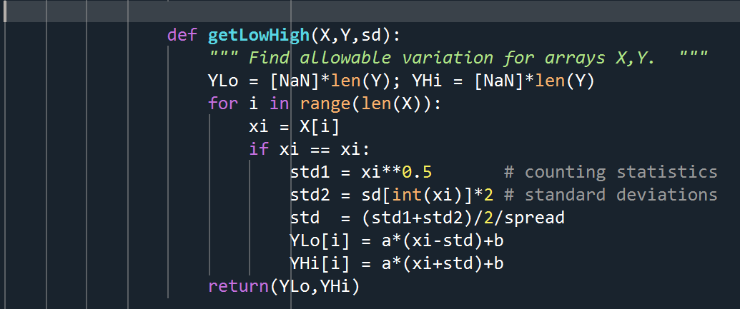
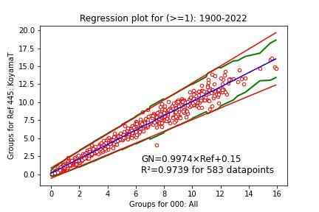
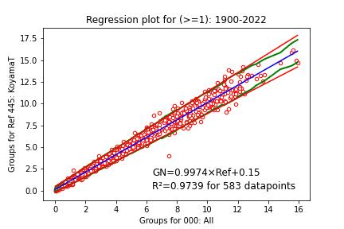
Outlier Elimination
The ‘spread’ parameter controls how thight the regression must be on order to identify outliers.
Spread = 1.0
Spread = 2.0

Slide 23
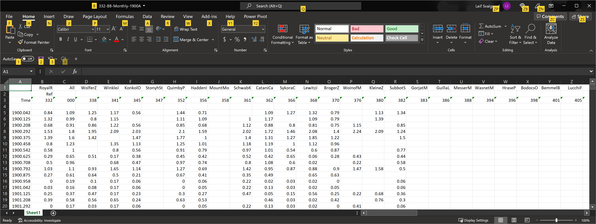
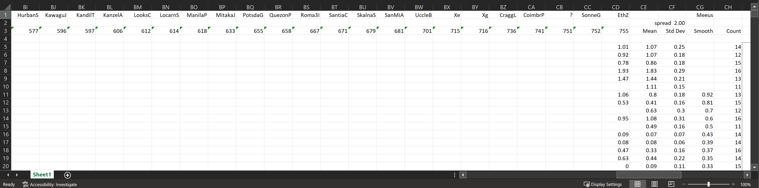
Excel Spreadsheet for RGO BB

Slide 24
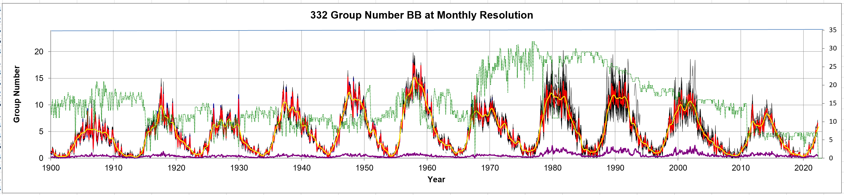
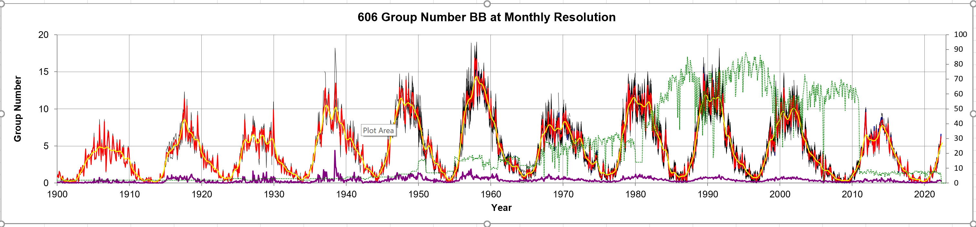
RGO and Kanzelhöhe
The Spreadsheet was created using library xlsxwriter written by John McNamara. Find him at https://github.com/jmcnamara

Slide 25
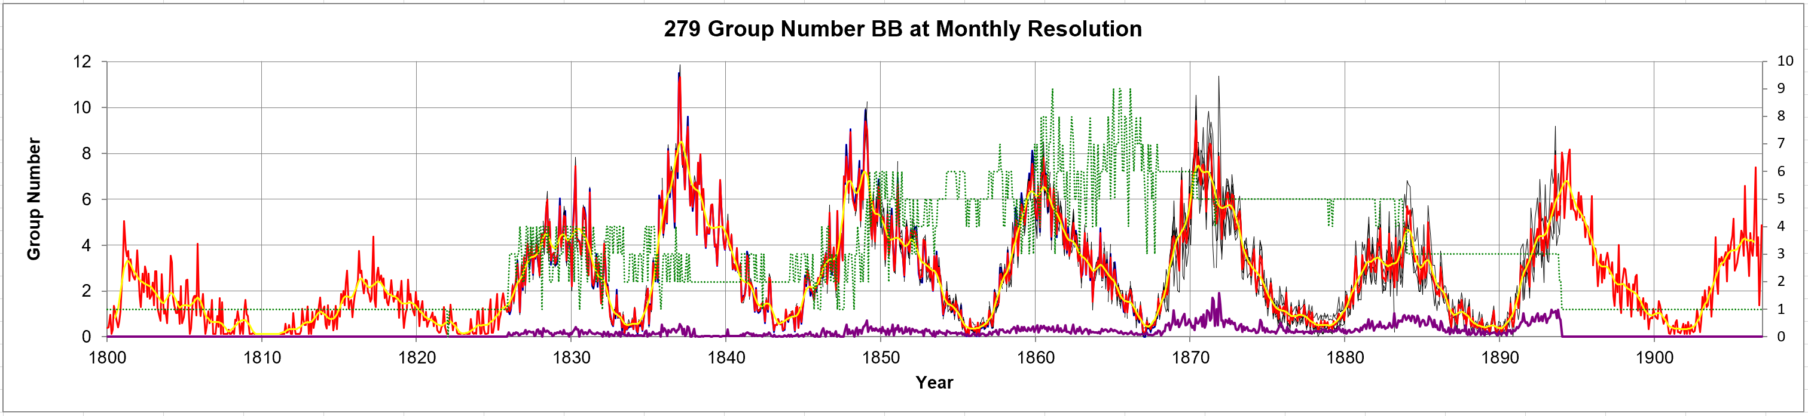
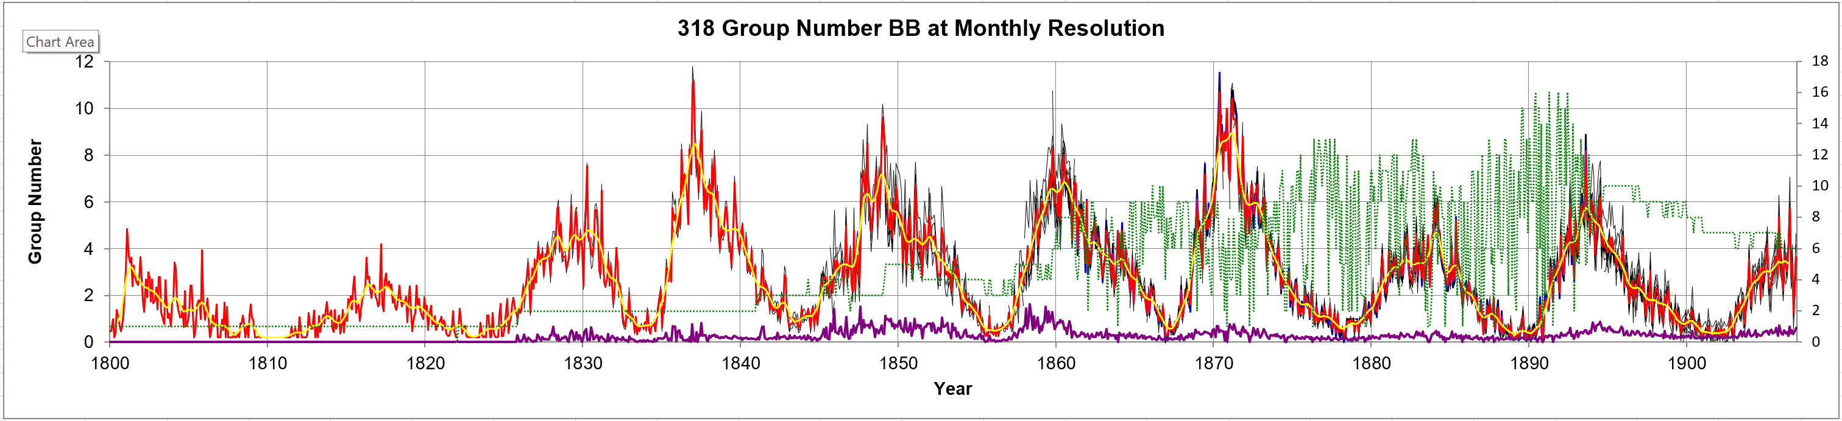
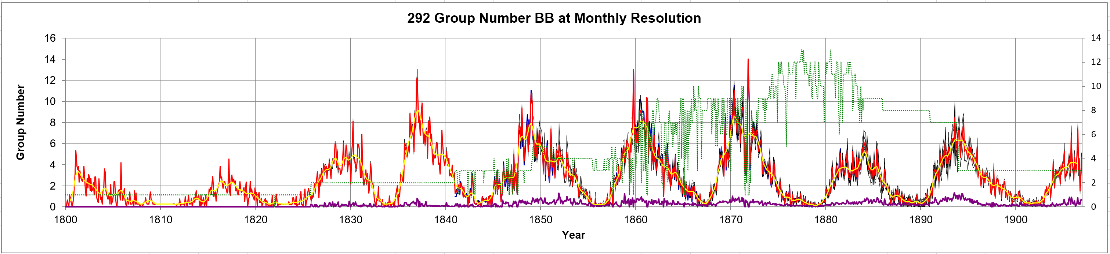
Schwabe, Spörer, and Schmidt

Slide 26
https://www.youtube.com/watch?v=KBeBILC7r4Y

Slide 27
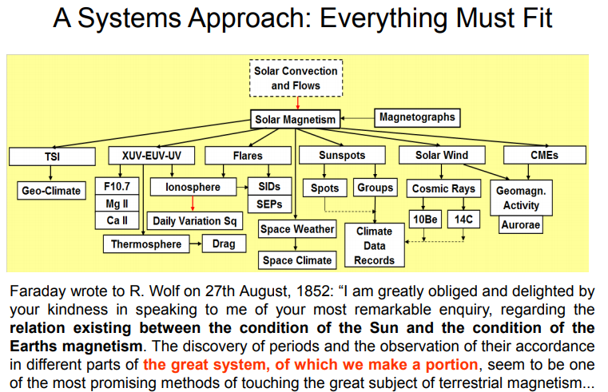
We have discovered many phenomena caused by or modulated by solar activity. One of the clearest was Wolf’s discovery of a geomagnetic variation depending on solar activity [Wolf communicated his discovery to Michael Faraday who saw that we are all part of a great system. Today we are beginning to understand how that system works and can use the observed relationships to validate our indices:
Hard, if we cannot agree on measures of ‘Solar Activity’
Causes
Wave radiation
Particle radiation
Sun
Proxies
Effects

Slide 28
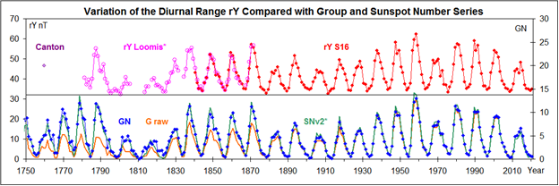
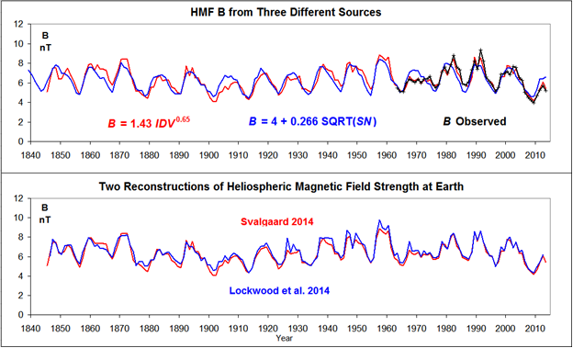
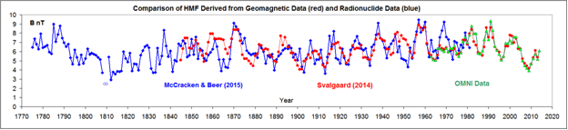
Proxies for the Solar Magnetic Field
Solar Extreme Ultraviolet Radiation and the Diurnal Variation of the Geomagnetic field
Graham (1724) discovered that the angle between the horizontal component of the geomagnetic field and true north, varied through the day. Wolf (1852) and Gautier (1852), found it to vary with the number of sunspots. Here are yearly values of the diurnal range, rY, of variation of the East Component of the geomagnetic field as determined by Canton (1759), Loomis (1870), and Svalgaard (2016)
Heliomagnetic Field Strength in Solar Wind Deduced from Geomagnetic IDV-index
Heliospheric magnetic field, B, near the Earth inferred from the IDV-index (red curve), from the sunspot number (v2, blue curve), and observed by spacecraft (OMNI data, black curve). The IDV-index measures the energy content of the Van Allen Belts around the Earth (the ‘Ring Current’) depending directly on the strength of the solar wind magnetic field.
Heliomagnetic Field in Solar Wind from Cosmic Ray-Created Radionuclide Data
Yearly values of the heliospheric magnetic field, B, near the Earth inferred from the IDV-index (red symbols; Svalgaard, 2014), from the cosmic ray record (blue symbols; McCracken and Beer, 2015), and in-situ observed (OMNI data, green triangle symbols).

Slide 29
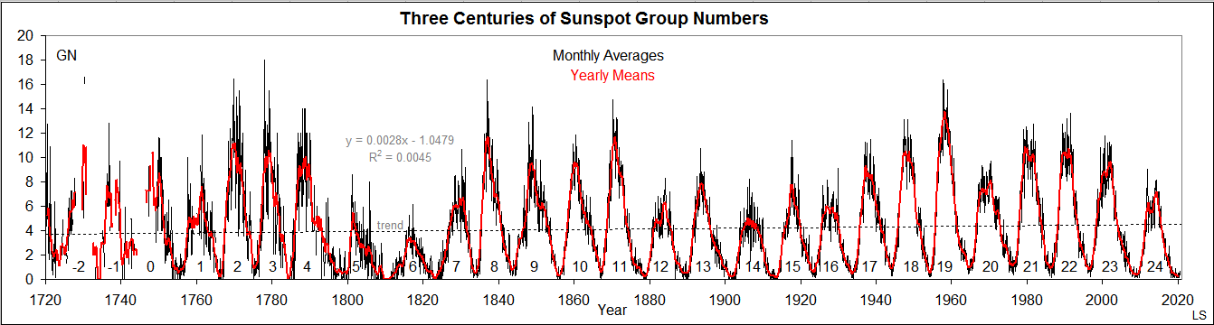
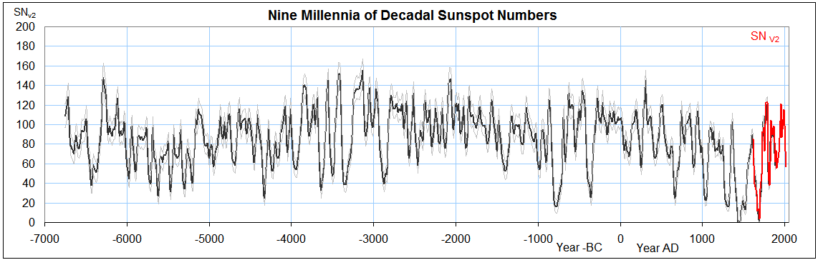
The Resulting Big Picture
From Cosmic Rays, Wu et al. 2018

Slide 30
Extended Abstract
The reconstruction of solar activity in the past is important for understanding and prediction of said activity. There are basically two lines of attack: (1) direct observation(s) of the sun and (2) observations of the effect(s) of solar activity. It is widely acknowledged that the sun is a variable star. On timescales of a few centuries (which are of immediate societal concerns), solar variability is that of its magnetic field. Ever since Hale discovered that sunspots are magnetic it has been clear that the number (or area) of sunspots must be an indicator (or proxy) of solar magnetic fields. It has long been realized that the fundamental measure of activity must be the number of sunspot groups [active regions], and that the appearance of a new group [no matter how small] is more important than the appearance of just a new spot among the sometimes hundreds of existing spots. The traditional [Relative] sunspot number defined by Rudolf Wolf in the 1850s takes that into account by according to the number of groups [seen on the solar disk] ten times the weight of the number of spots. Douglas Hoyt and Ken Schatten [H&S] in the 1990s proposed to measure solar activity by the number of groups alone. This measure [when appropriately scaled] agrees well with the sunspot number [after correcting the latter for various systematic errors] but disagrees markedly [up 40%-50% lower] before about the year 1882. The disagreement has been traced to a mistake in the scaling of the H&S Group Sunspot Number before 1882. [The same] Ken Schatten and I developed a novel way of harmonizing the observations by different observers to a common primary observer over a long period of time [50-100 years], the primary observer serving as a 'Backbone' onto which all other observers are 'hooked' by direct comparison. The total long-term solar activity series is then formed by linking a small [~4-5] number of such backbones, choosing one in the middle of the time span to set the scale of the series in order to minimize the effect of error propagation. Our series removed the discrepancy with the sunspot number and agreed well with the various indirect series of the effects of solar activity. Fortunately, several other [~7] approaches to constructing a group number series have been proposed and there is no consensus [as yet] about which one to work with, leaving that choice a free parameter in correlative studies [e.g., on solar influence on Climate Change]. I say 'fortunately' because that means that this problem is now an active area of research, rather than a 'cast in stone' series that must be accepted on faith [or bias]. Hoyt and Schatten assembled a very valuable database of about 500,000 observations since 1610 [many not known to Wolf]. New observations and revised series of historical observations are steadily added to the database which now contains more than a million observations. The [moving target] data are freely available and form the basic input to most reconstructions of solar activity. I'll discuss a tool to 'teach' a machine [a 1000-line Python program] to construct [in typically 15 minutes] backbones for any given primary observer automatically [with no further input from the researcher]. This makes the process transparent and reproducible [as there are no further hidden assumptions], leaving the linking of backbones as the real issue with much starker drawn lines to form a base for scientific discussions [and potential consensus].

