Slide 1
Sunspot Area as SSN Correlate: Greenwich and Beyond

Slide 2
Observations of Area of Sunspots
-Greenwich measurements 1874-1976 (three stations, Cape of Good Hope,
Kodaikanal (1906-1987) and Mauritius)
- Solar Observatories network in U.S.S.R/Russia, (1950th – 2010?)
- USAF (SOON) network, (Holloman, Learmonth, Palehua, Ramey and San
Vito, Boulder, MWO).
Debrecen (1977-1998), Rome (1957-2000), Yunnan, and Catania (1978-1999)

Slide 3
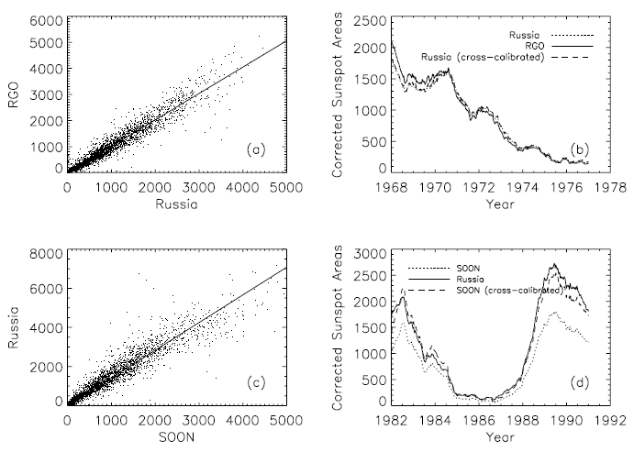
Balmaceda et al, 2010

Slide 4
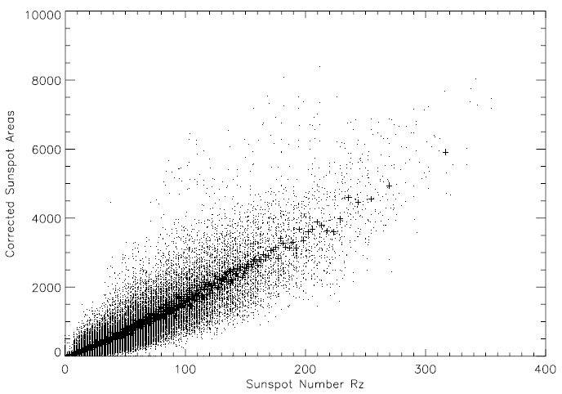
Correlation between Rz and Area
Balmaceda et al, 2010

Slide 5
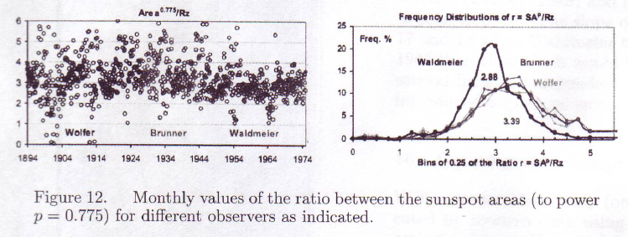
Correlation between Rz and Area
L. Svalgaard, 2010

Slide 6
P. Foukal’s comments
- The RGO spot areas were ~ 1.4- 1.5 x larger than the USAF values. There probably is a scale change after 1976 but its explanation is still a mystery. […] it is not just because RGO counted smaller spots (as Balmaceda et al claimed).
- Whatever explanation is proposed also has to address the fact that the RGO and Rome scales seem to agree for the entire descending phase of cycle 20, when they still overlap. As can be seen in the Fig 3 of the Fligge & Solanki paper, and it is not until the ascending phase of cycle 21 that major differences appear.
- Dave’s (Hathaway) factor of 1.4 was derived by comparing MTW and RGO umbral areas. He used the Gilman & Gilman measurements of the MTW plates; these were rough measurements on umbrae only.
- Clearing up this scale difference will require acquiring detailed understanding of how exactly the measurements were made at RGO, Rome, etc. Pat McIntosh […] trained the USAF observers and still has the original templates etc used for measuring the spot areas. If we are serious about solving this problem we should get those from him. […] spent some time at RGO in the early 1990’s understanding how they made their WL faculae area measurements. Again, we could get the exact information on how they measured spots.

Slide 7
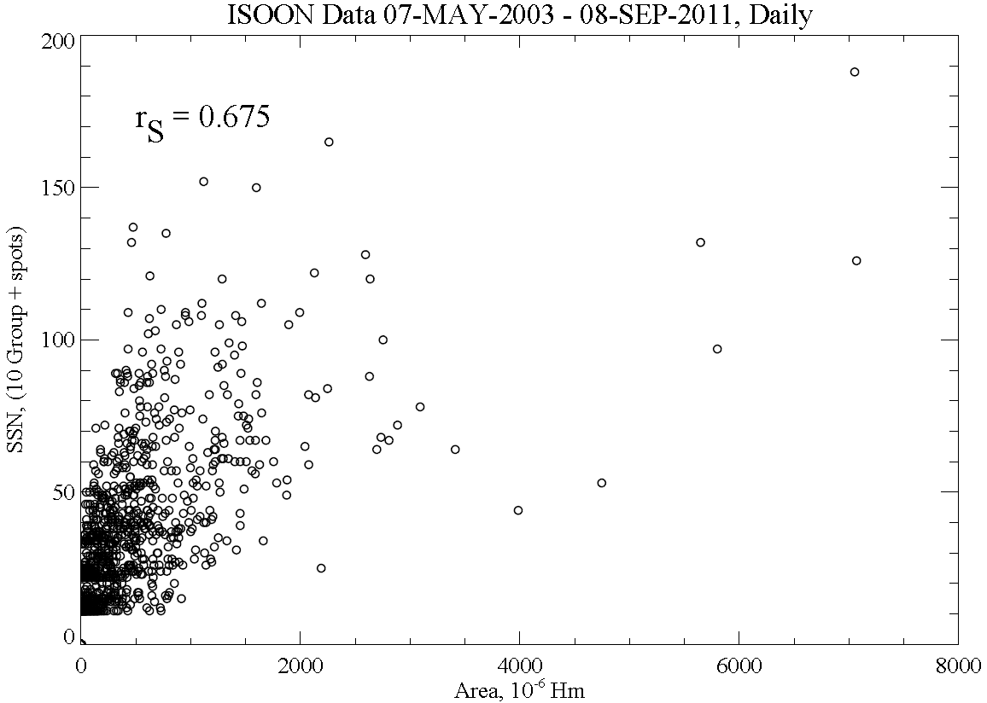
Do Really Rz and Area Correlate Well?
First clue: daily measurements show weak correlation

Slide 8
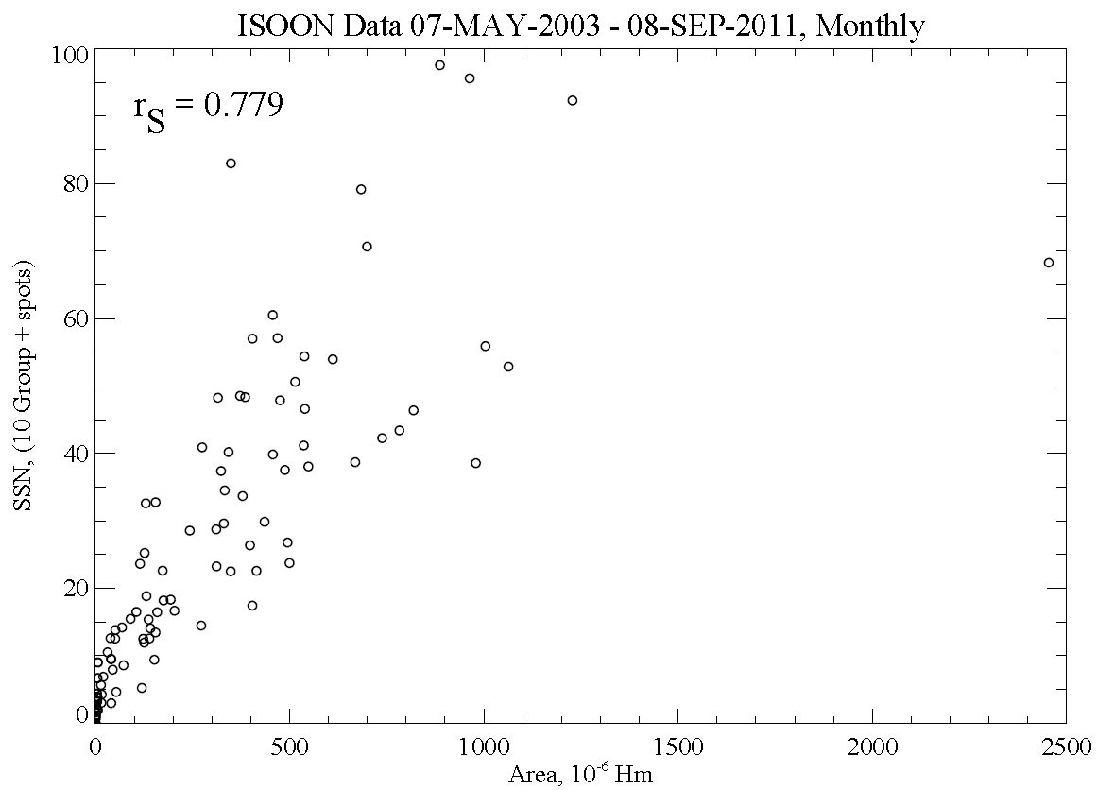
Second clue: Correlation improves with larger averaging

Slide 9
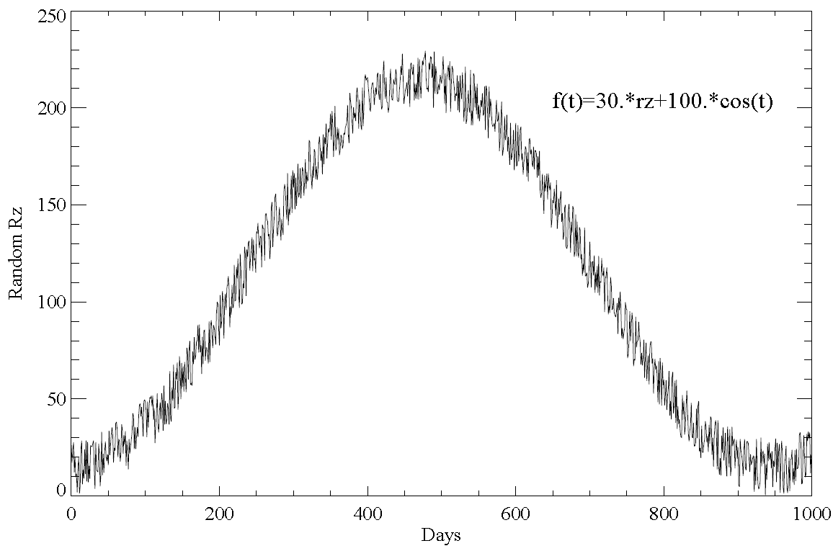
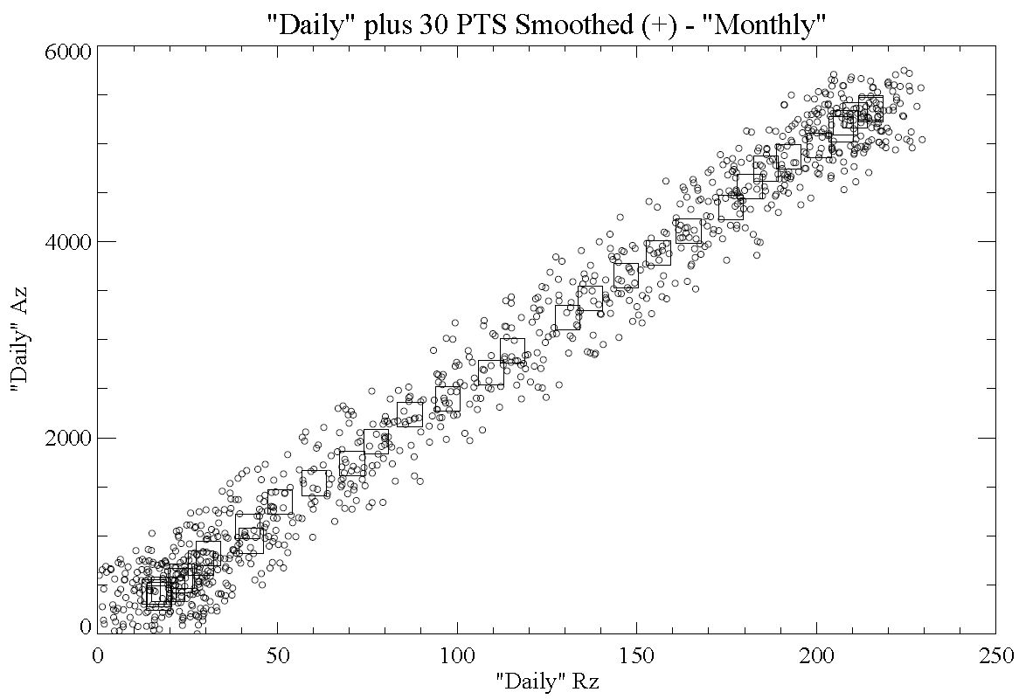
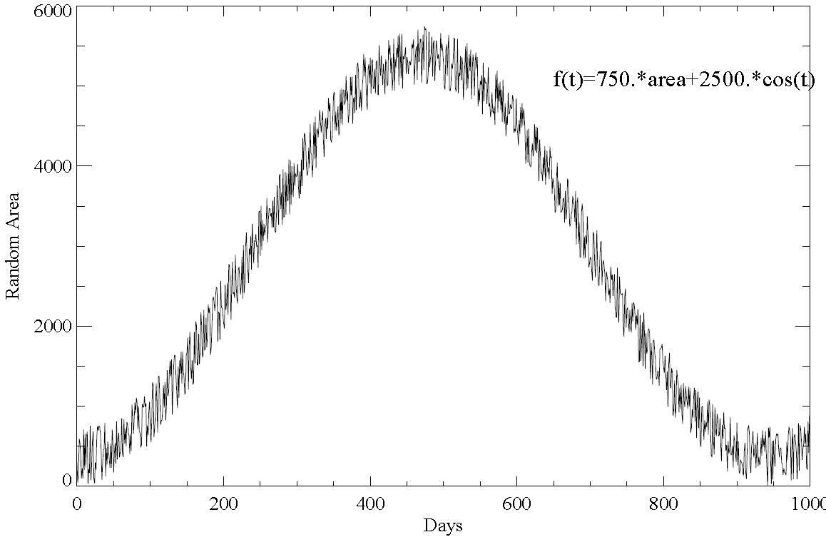
Is Rz-Area Correlation due to multi-correlations?

Slide 10
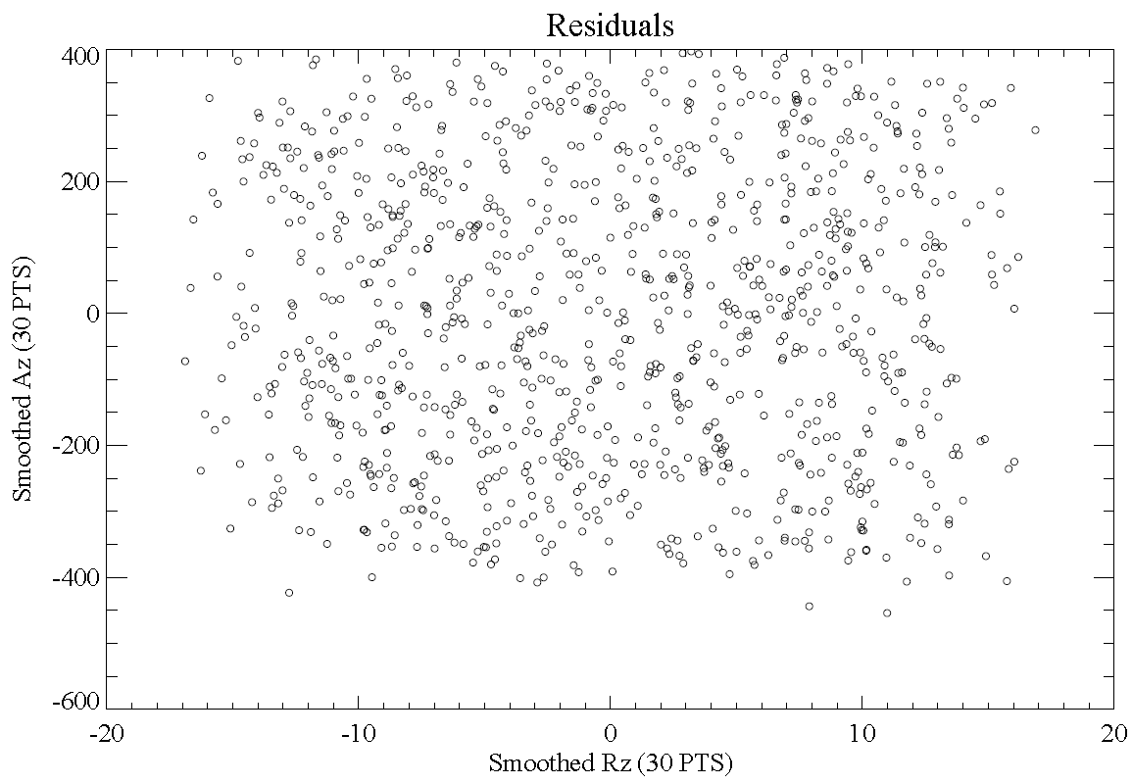
Finding True Rz-Area Correlation

Slide 11
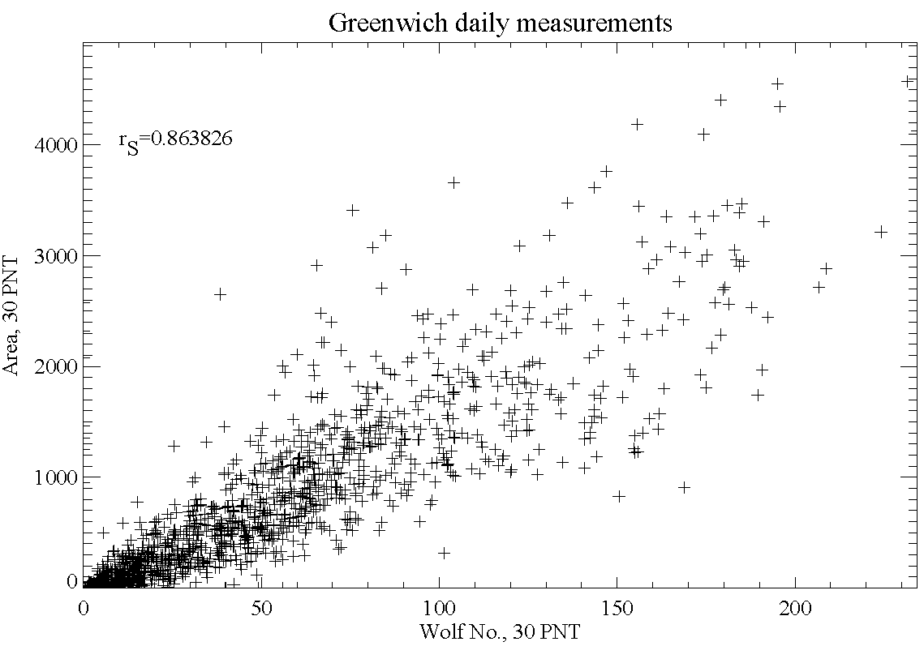
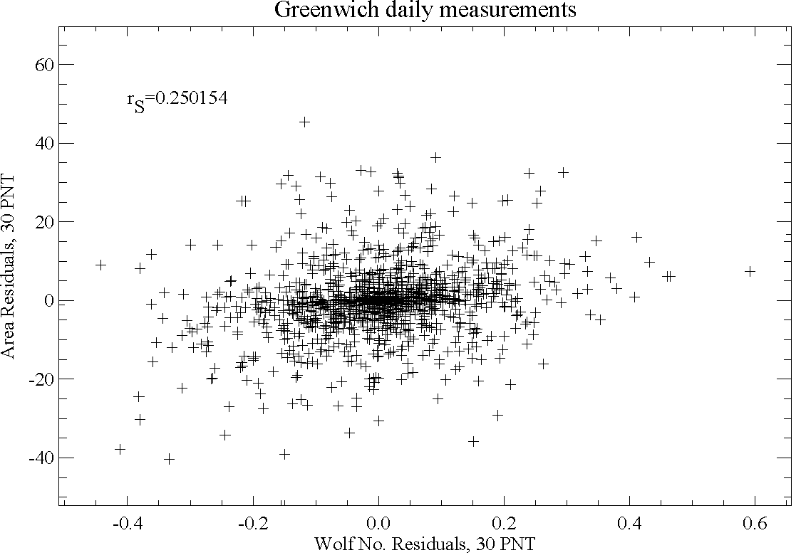
Correlation between Rz and Area
Correlation between Area and Rz is mostly due to their correlation to level of activity
When dependency on level of activity is removed, Rz and A show weak correlation.

